Slide 1
Advance Database Management System Lecture 11: Database Transaction

Slide 2
Learning Objectives
To know about:
Types of SQL Commands
Database Transaction
Transaction Control Language (TCL)
COMMIT
ROLLBACK
SAVEPOINT

Slide 3
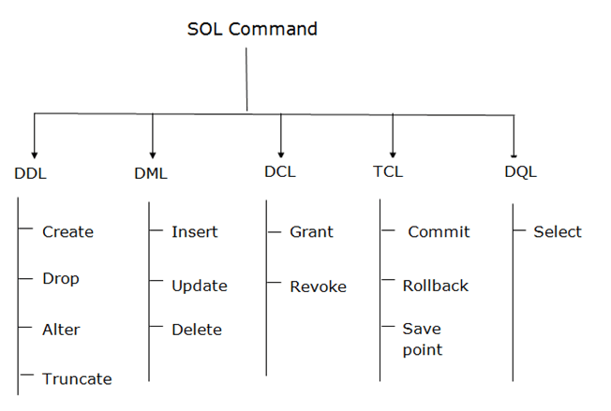
Types of SQL Commands

Slide 4
What is Transaction?
A transaction is a set of SQL statements which Oracle treats as a Single Unit. i.e. all the statements should execute successfully or none of the statements should execute.
To control transactions Oracle does not made permanent any DML statements unless you commit it. If you don’t commit the transaction and power goes off or system crashes then the transaction is roll backed.

Slide 5
Transaction Control Language (TCL)
Transaction control statements manage changes made by DML statements.
TCL Statements available in Oracle are
COMMIT : Make changes done in transaction permanent. ROLLBACK : Rollbacks the state of database to the last commit point. SAVEPOINT : Use to specify a point in transaction to which later you can rollback.

Slide 6
COMMIT
To make the changes done in a transaction permanent issue the COMMIT statement
Example:
insert into emp (empno,ename,sal) values (101,’Abid’,2300);
commit;

Slide 7
ROLLBACK
To rollback the changes done in a transaction give rollback statement. Rollback restore the state of the database to the last commit point.
Example :
delete from emp;
rollback;

Slide 8
SAVEPOINT
Specify a point in a transaction to which later you can roll back.
Example
insert into emp (empno,ename,sal) values (109,’Sami’,3000); savepoint a; insert into dept values (10,’Sales’,’Hyd’); savepoint b; insert into salgrade values(‘III’,9000,12000);
Notes:
SAVEPOINT Example Explanation
--------------------------------------------
Now if you give
rollback to a;
Then row from salgrade table and dept will be roll backed. At this point you can commit the row inserted into emp table or rollback the transaction.
If you give
rollback to b;
Then row inserted into salgrade table will be roll backed. At this point you can commit the row inserted into dept table and emp table or rollback to savepoint a or completely roll backed the transaction.
If you give
rollback;
Then the whole transactions is roll backed.
If you give
commit;
Then the whole transaction is committed and all savepoints are removed.

Slide 9
THANK YOU

